Slide 1
HE3002 Macroeconomics III
Sem 1 – AY 24/25
Problem Set 1

Slide 2
Question 1
Using the information in Lecture 1, label each of the following statements true, false or uncertain. Explain briefly.
(a) Although the export ratio can be larger than one, as it is in Singapore, the same cannot be true of the ratio of imports to GDP.
(b) Uncovered interest parity implies that interest rates must be the same across countries.
(c) The nominal exchange rate and the real exchange rate always move in the same direction.
(d) If the dollar is expected to appreciate against the yen, uncovered interest parity implies that the US nominal interest rate must be greater than the Japanese nominal interest rate.

Slide 3
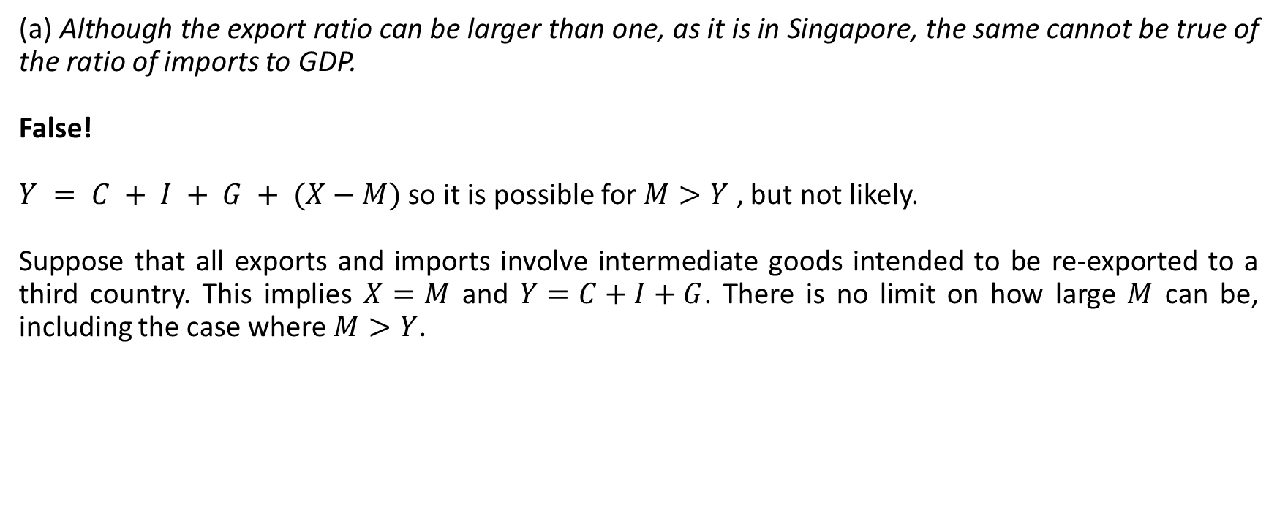
Question 1
(a) Although the export ratio can be larger than one, as it is in Singapore, the same cannot be true of the ratio of imports to GDP.
False!
$Y = C + I + G + (X−M)$ so it is possible for $M>Y$ , but not likely.
Suppose that all exports and imports involve intermediate goods intended to be re-exported to a third country. This implies $X=M$ and $Y=C+I+G$. There is no limit on how large $M$ can be, including the case where $M>Y$.

Slide 4









Question 1
(b) Uncovered interest parity implies that interest rates must be the same across countries.
Year $t$
Year $t+1$
False! UIP suggest that:
$$1+i_{t}=\frac{\left(1+i_{t}^{∗}\right)E_{t}}{E_{t+1}^{e}}$$
So that financial investors are indifferent between domestic (US) bonds and foreign (UK) bonds.
It implies that interest rates can be different between 2 countries, but FX will adjust to make returns equivalent.
$$\$1$$
$$\$1×\left(1+i_{t}\right)$$
$$\$1×\frac{E_{t}\left(1+i_{t}^{∗}\right)}{E_{t+1}^{e}}$$
$$\$1×E_{t}$$
$$\$1×E_{t}\left(1+i_{t}^{∗}\right)$$
$E_{t}$ is the price of $US\$$ in $£$

Slide 5
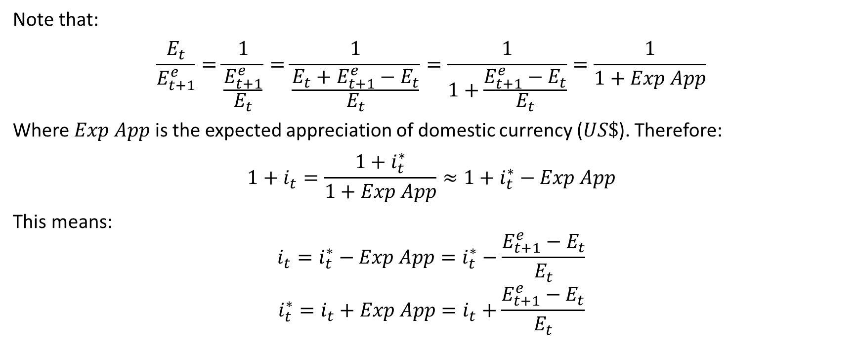
Question 1
Note that:
$$\frac{E_{t}}{E_{t+1}^{e}}=\frac{1}{\frac{E_{t+1}^{e}}{E_{t}}}=\frac{1}{\frac{E_{t}+E_{t+1}^{e}−E_{t}}{E_{t}}}=\frac{1}{1+\frac{E_{t+1}^{e}−E_{t}}{E_{t}}}=\frac{1}{1+Exp App}$$
Where $Exp App$ is the expected appreciation of domestic currency ($US\$$). Therefore:
$$1+i_{t}=\frac{1+i_{t}^{∗}}{1+Exp App}≈1+i_{t}^{∗}−Exp App$$
This means:
$$i_{t}=i_{t}^{∗}−Exp App=i_{t}^{∗}−\frac{E_{t+1}^{e}−E_{t}}{E_{t}}$$
$$i_{t}^{∗}=i_{t}+Exp App=i_{t}+\frac{E_{t+1}^{e}−E_{t}}{E_{t}}$$

Slide 6
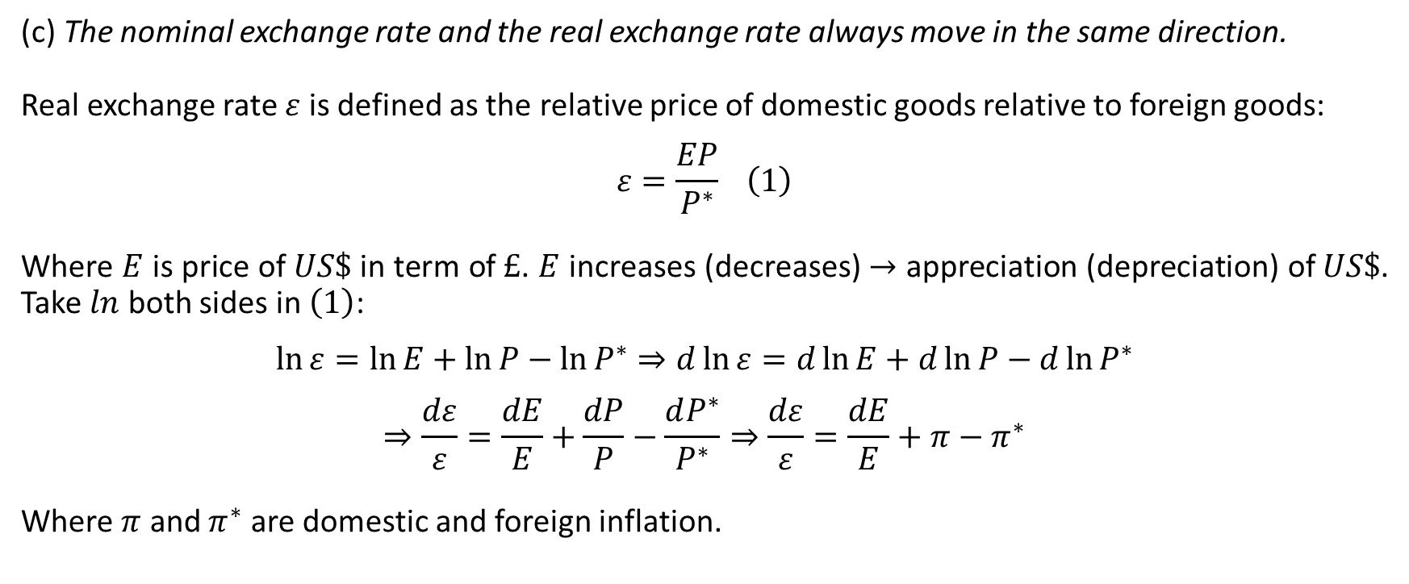
Question 1
(c) The nominal exchange rate and the real exchange rate always move in the same direction.
Real exchange rate $ε$ is defined as the relative price of domestic goods relative to foreign goods:
$$ε=\frac{EP}{P^{∗}} \left(1\right)$$
Where $E$ is price of $US\$$ in term of $£$. $E$ increases (decreases) $→$ appreciation (depreciation) of $US\$$. Take $ln$ both sides in $\left(1\right)$:
$$\ln{ε=\ln{E}+\ln{P}−\ln{P^{∗}}}⇒d\ln{ε}{=d\ln{E}+d\ln{P}−d\ln{P^{∗}}}$$
$$⇒\frac{dε}{ε}=\frac{dE}{E}+\frac{dP}{P}−\frac{dP^{∗}}{P^{∗}}⇒\frac{dε}{ε}=\frac{dE}{E}+π−π^{∗}$$
Where $π$ and $π^{∗}$ are domestic and foreign inflation.

Slide 7
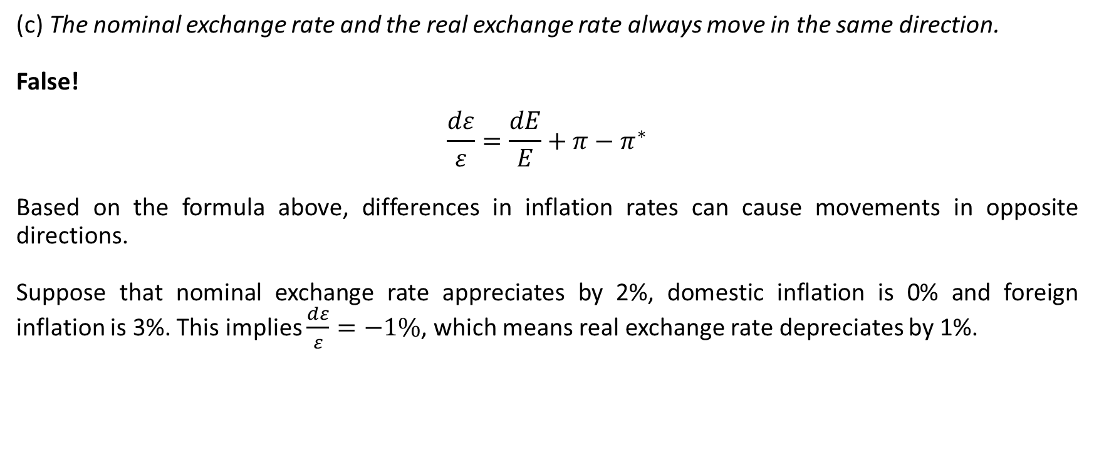
Question 1
(c) The nominal exchange rate and the real exchange rate always move in the same direction.
False!
$$\frac{dε}{ε}=\frac{dE}{E}+π−π^{∗}$$
Based on the formula above, differences in inflation rates can cause movements in opposite directions.
Suppose that nominal exchange rate appreciates by 2%, domestic inflation is 0% and foreign inflation is 3%. This implies $\frac{dε}{ε}=−1\%$, which means real exchange rate depreciates by 1%.

Slide 8
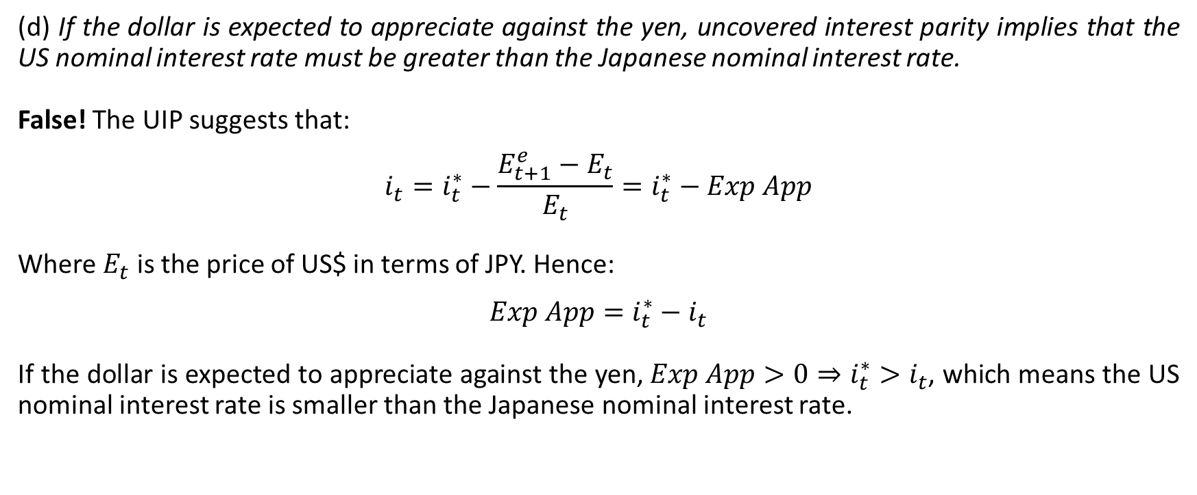
Question 1
(d) If the dollar is expected to appreciate against the yen, uncovered interest parity implies that the US nominal interest rate must be greater than the Japanese nominal interest rate.
False! The UIP suggests that:
$$i_{t}=i_{t}^{∗}−\frac{E_{t+1}^{e}−E_{t}}{E_{t}}=i_{t}^{∗}−Exp App$$
Where $E_{t}$ is the price of US$ in terms of JPY. Hence:
$$Exp App=i_{t}^{∗}−i_{t}$$
If the dollar is expected to appreciate against the yen, $Exp App>0⇒i_{t}^{∗}>i_{t}$, which means the US nominal interest rate is smaller than the Japanese nominal interest rate.

Slide 9

Question 2
Show that by approximation,
$$1+i_{t}=\frac{1+i_{t}^{∗}}{1+\frac{E_{t+1}^{e}−E_{t}}{E_{t}}}$$
can be expressed as:
$$i_{t}=i_{t}^{∗}−\frac{E_{t+1}^{e}−E_{t}}{E_{t}}$$
Note:
$$Exp App=\frac{E_{t+1}^{e}−E_{t}}{E_{t}}$$

Slide 10
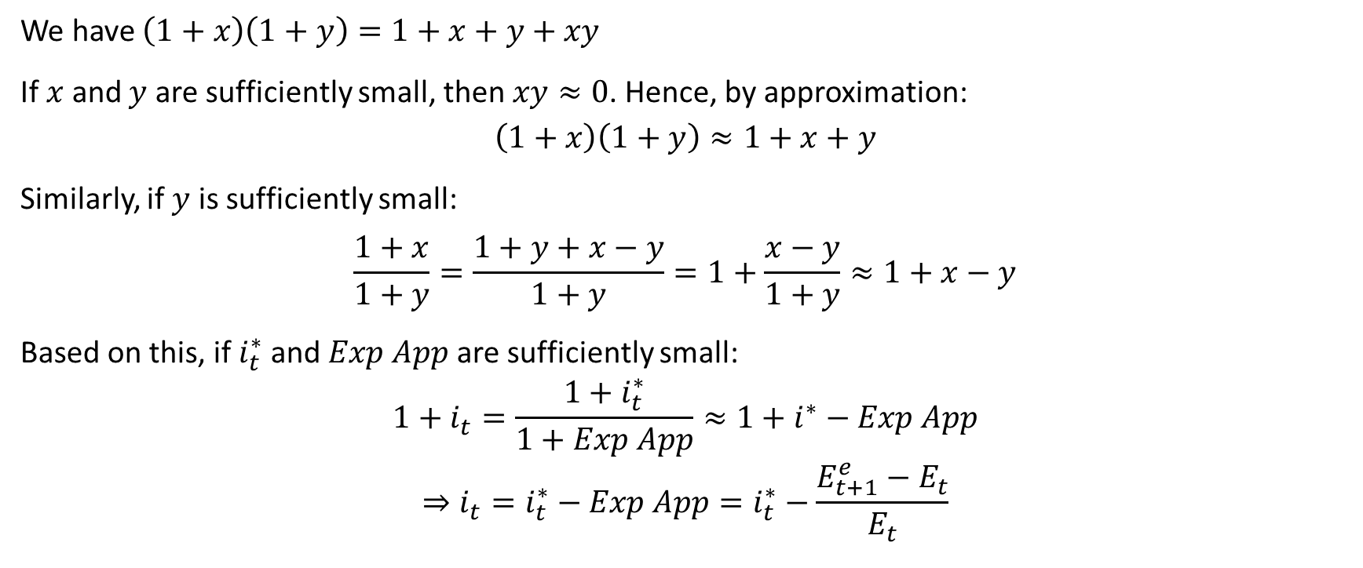
Question 2
We have $\left(1+x\right)\left(1+y\right)=1+x+y+xy$
If $x$ and $y$ are sufficiently small, then $xy≈0$. Hence, by approximation:
$$\left(1+x\right)\left(1+y\right)≈1+x+y$$
Similarly, if $y$ is sufficiently small:
$$\frac{1+x}{1+y}=\frac{1+y+x−y}{1+y}=1+\frac{x−y}{1+y}≈1+x−y$$
Based on this, if $i_{t}^{∗}$and $Exp App$ are sufficiently small:
$$1+i_{t}=\frac{1+i_{t}^{∗}}{1+Exp App}≈1+i^{∗}−Exp App$$
$$⇒i_{t}=i_{t}^{∗}−Exp App=i_{t}^{∗}−\frac{E_{t+1}^{e}−E_{t}}{E_{t}}$$

Slide 11

Question 2
For example, let $i_{t}^{∗}=5\%$ and $Exp App=2\%$.
Original formula:
$$1+i_{t}=\frac{1+i_{t}^{∗}}{1+Exp App}=\frac{1+0.05}{1+0.02}=1.0294$$
$$⇒i_{t}=0.0294 or 2.94\%$$
Approximation formula:
$$i_{t}=i_{t}^{∗}−Exp App=5\%−2\%=3\%$$

Slide 12
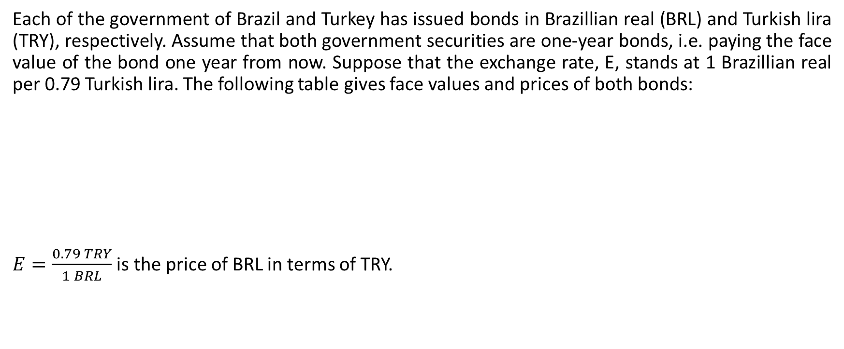
Question 3
Each of the government of Brazil and Turkey has issued bonds in Brazillian real (BRL) and Turkish lira (TRY), respectively. Assume that both government securities are one-year bonds, i.e. paying the face value of the bond one year from now. Suppose that the exchange rate, E, stands at 1 Brazillian real per 0.79 Turkish lira. The following table gives face values and prices of both bonds:
$E=\frac{0.79 TRY}{1 BRL}$ is the price of BRL in terms of TRY.
 | Face Value | Price
Brazil | BRL10,000 | BRL9,630
Turkey | TRY10,000 | TRY9,450

Slide 13
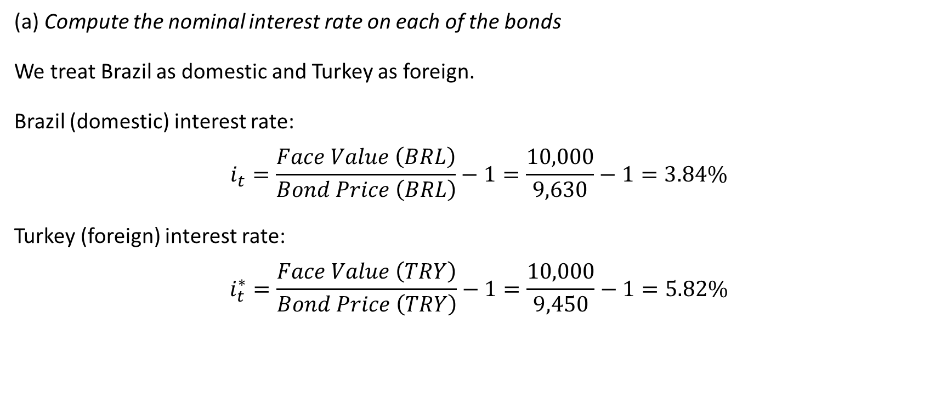
Question 3
(a) Compute the nominal interest rate on each of the bonds
We treat Brazil as domestic and Turkey as foreign.
Brazil (domestic) interest rate:
$$i_{t}=\frac{Face Value \left(BRL\right)}{Bond Price \left(BRL\right)}−1=\frac{10,000}{9,630}−1=3.84\%$$
Turkey (foreign) interest rate:
$$i_{t}^{∗}=\frac{Face Value \left(TRY\right)}{Bond Price \left(TRY\right)}−1=\frac{10,000}{9,450}−1=5.82\%$$

Slide 14
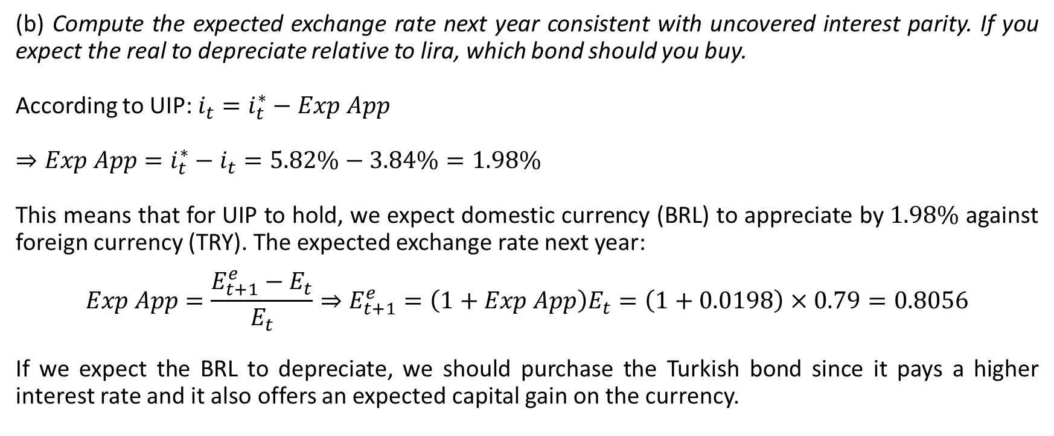
Question 3
(b) Compute the expected exchange rate next year consistent with uncovered interest parity. If you expect the real to depreciate relative to lira, which bond should you buy.
According to UIP: $i_{t}=i_{t}^{∗}−Exp App$
$⇒Exp App=i_{t}^{∗}−i_{t}=5.82\%−3.84\%=1.98\%$
This means that for UIP to hold, we expect domestic currency (BRL) to appreciate by $1.98\%$ against foreign currency (TRY). The expected exchange rate next year:
$$Exp App=\frac{E_{t+1}^{e}−E_{t}}{E_{t}}⇒E_{t+1}^{e}=\left(1+Exp App\right)E_{t}=\left(1+0.0198\right)×0.79=0.8056$$
If we expect the BRL to depreciate, we should purchase the Turkish bond since it pays a higher interest rate and it also offers an expected capital gain on the currency.

Slide 15
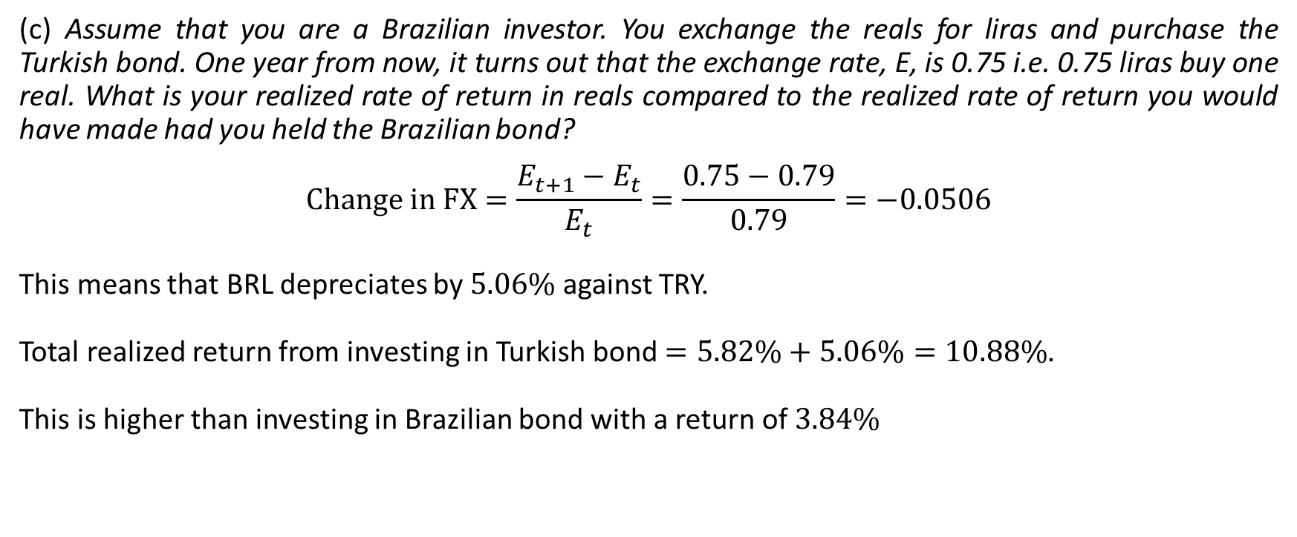
Question 3
(c) Assume that you are a Brazilian investor. You exchange the reals for liras and purchase the Turkish bond. One year from now, it turns out that the exchange rate, E, is 0.75 i.e. 0.75 liras buy one real. What is your realized rate of return in reals compared to the realized rate of return you would have made had you held the Brazilian bond?
$$Change in FX=\frac{E_{t+1}−E_{t}}{E_{t}}=\frac{0.75−0.79}{0.79}=−0.0506$$
This means that BRL depreciates by $5.06\%$ against TRY.
Total realized return from investing in Turkish bond $=5.82\%+5.06\%=10.88\%$.
This is higher than investing in Brazilian bond with a return of $3.84\%$

Slide 16
Question 3
(d) Are the differences in rates of return in part (c) consistent with the uncovered interest parity condition? Explain your answer.
Yes, the differences in rates of return here are still consistent with the UIP condition.
The UIP condition is about equality of expected returns, not equality of actual (realized) returns.
In this case, the investor in Turkish bond experiences a higher realized return due to unexpected gain from BRL depreciation, rather than getting the expected appreciation implied by UIP.

